Slide 1


[Social Buzz]

Slide 2


Today's agenda
Project recap
Problem
The Analytics team
Process
Insights
Summary

Slide 3

Social Buzz is a fast-growing technology unicorn that need to adapt quickly to its global scale. Accenture has begun a 3-month POC focusing on these objectives:
An audit of their big data practice
Recommendations for a successful IPO
An analysis of their content categories that highlights the top 5 categories with the largest aggregate popularity
Project Recap

Slide 4

Problem
Over 100,000 posts a day
36,500,000 pieces of content per year
What are the Top 5 Popular Categories of Social Buzz?

Slide 5



Andrew Fleming (Chief Technical Architect)
The Analytics team
Marcus Rompton (Senior Principle)
Omari Brockington (Data Analyst)

Slide 6
Data Understanding
Process
1
2
Data Cleaning
3
Data Modeling
4
Data Analysis
5
Uncover Insights

Slide 7

Insights
1897 Reactions
Most Popular Category
16
Unique Categories
JANUARY
TOP MONTH

Slide 8
This chart demonstrates that the animal category beats out the others by a few thousands.
Top 5:
Animal
Food
Healthy Eating
Science
Technology

Slide 9
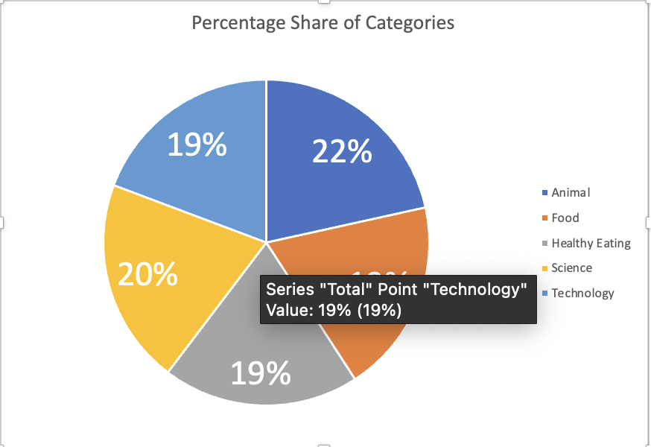

Slide 10

ANALYSIS:
Animals and Science are the most popular categories. Indicating that people love a mix between “real-life” and “factual content”
INSIGHT
Food is a common theme among the Top 5. I suggest launching an ad campaign around food working with healthy eating brands to boost user engagement
Summary

Slide 11

Thank you!
ANY QUESTIONS?

